Slide 1


DEV HACK 2020

Slide 2
TEAM NAME- KALI_TORJAN
SINJAN ROY
SWAGATO BAG
GARGI SAHA
ASHMITA DE
THEME DOMAIN- TRANSPORT

Slide 3
Problem Statement-How to make people use public transport more and also promote carpooling

Slide 4
SOLUTION (a)PUBLIC TRANSPORT
This solution is intended for- middle class people
Technology Used- Website that facilitates the submission and request of information to the database server.
Usefulness-
People who rely on the public transport their major concern is to know the real time location of the bus for which they are waiting for and the time it will take to reach their bus stop. This information helps people in making better travelling decisions. So, a real time monitoring system of location of buses has been designed.
Also, we have developed a central database to hold bus record bus and driver details. This inturn has 2 implementations-
User side-Users can see the status of various buses arrived, travelling, cancelled or delayed on entering the terminal.
Admin side- Admin can regularly update the details and they will be shown the report.

Slide 5
REAL TIME MONITORING
As the numbers of vehicles are increasing day by day,which leads to a serious problem of traffic congestion which leads to low accessibility, loss of travel time and pollution. The solution to this is to improve and expand the use of public transportation system.
Hence, using GPS, passengers will be able to get information about the arrival time of the transit vehicle.
Thus, for providing real time information, we find average travel time that is derived from the historical data.
Our model uses Location based services to get the passenger’s current GPS coordinates. These coordinates are sent to the server side where it is coordinated with the nearest bus stop.
The passenger selects the Bus number from the drop down and request is sent to the server. After processing, server sends the arrival time also passenger can locate the
bus’s current location on the map.

Slide 6
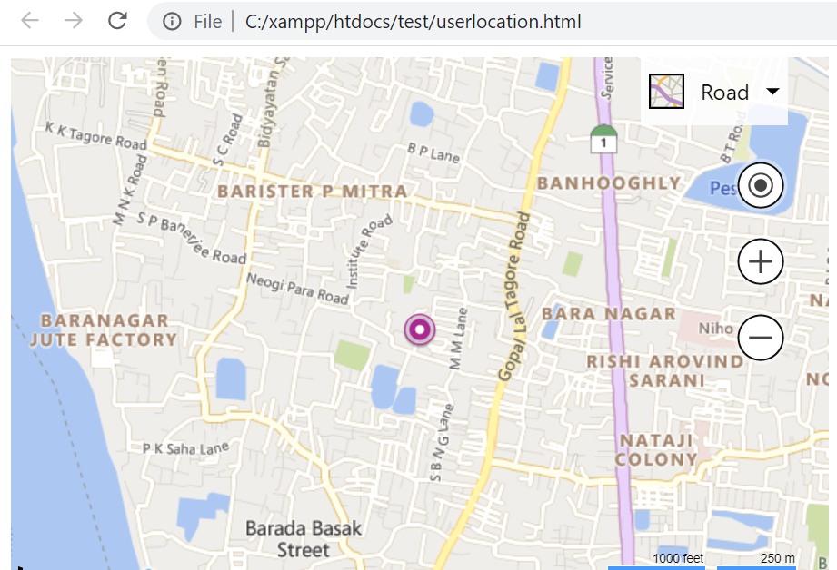
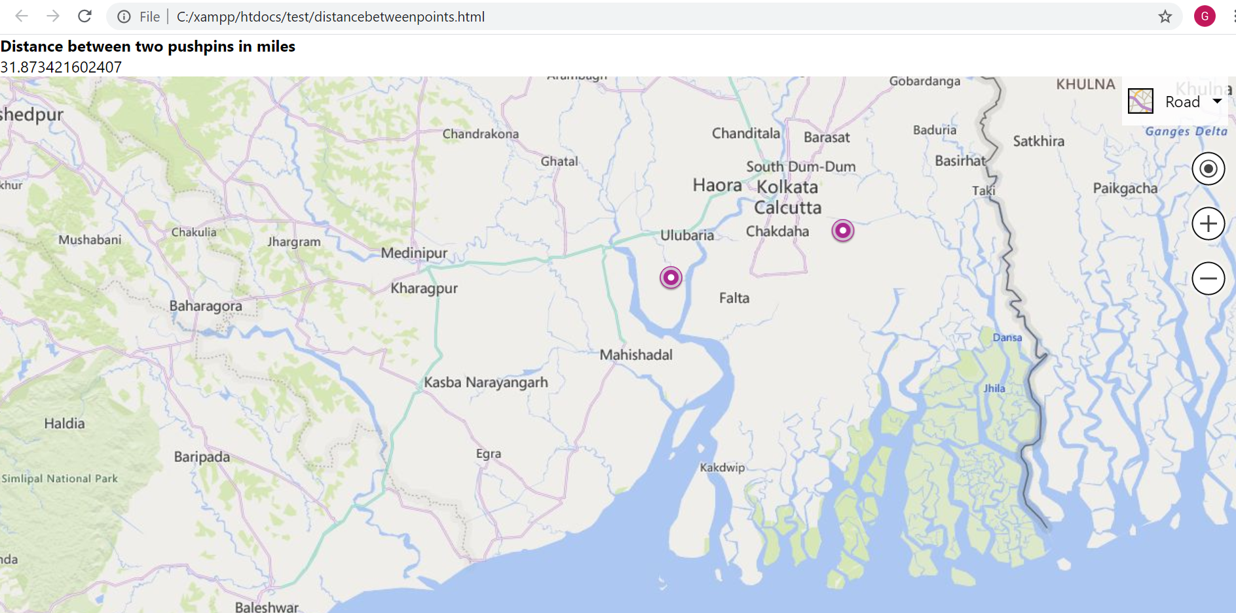
1. Showing location of user
2. Showing user location and location of bus
Our proposed model provides with user location navigation and also gives the distance between two destinations.

Slide 7
STATIC DATABASE
This module is the server side of the web application where most of the processing is done.
Web service is used that facilitates the submission and request of information to the database server.
Here, users can see the status of the buses- it's arrival time, departure time and updates on delayed and cancelled buses.
The admin can update the details of the buses, add or delete buses, and change drivers of the buses, if required.
Following snapshots will make it more clear-

Slide 8
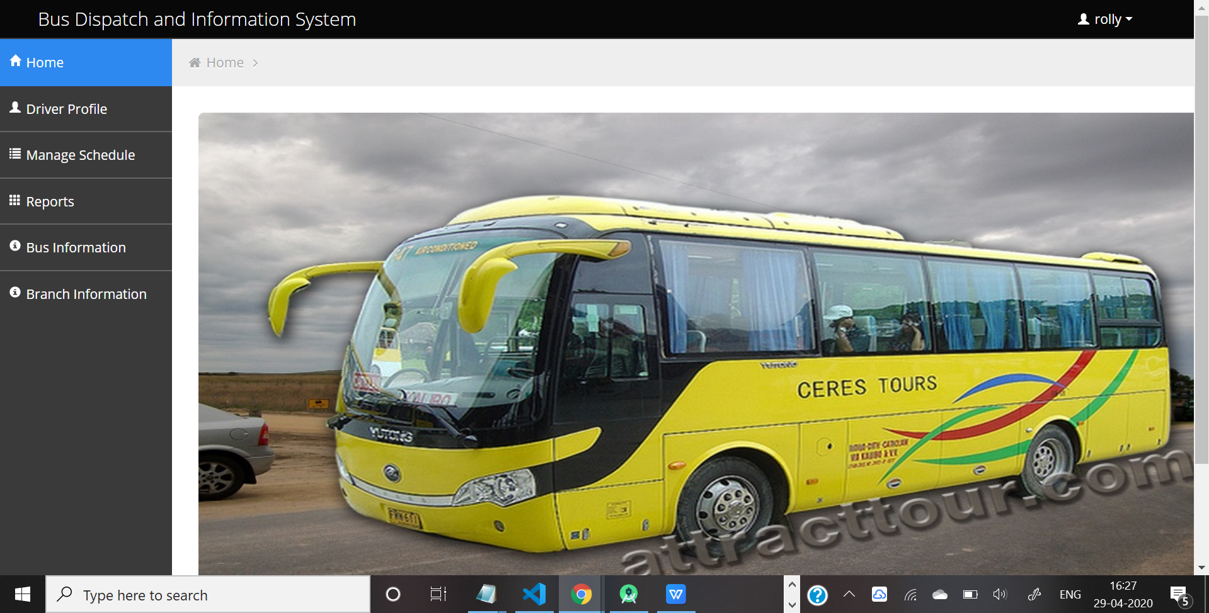
This is the admin screen upon login

Slide 9
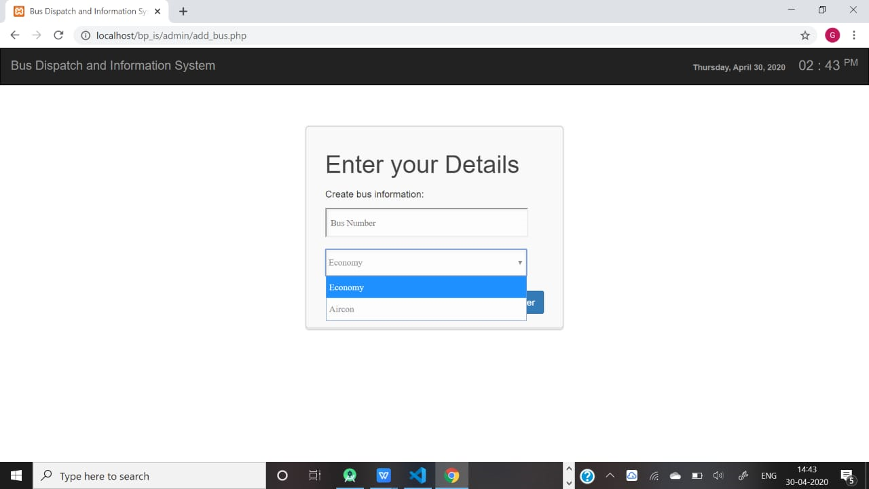
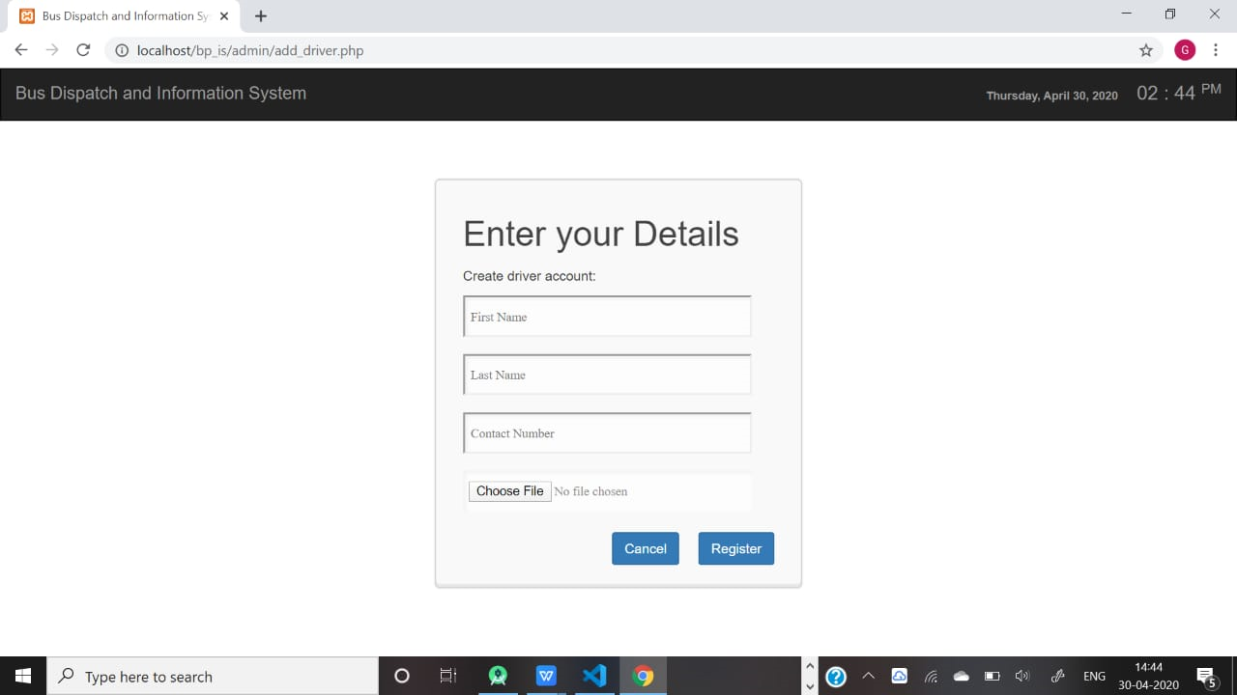
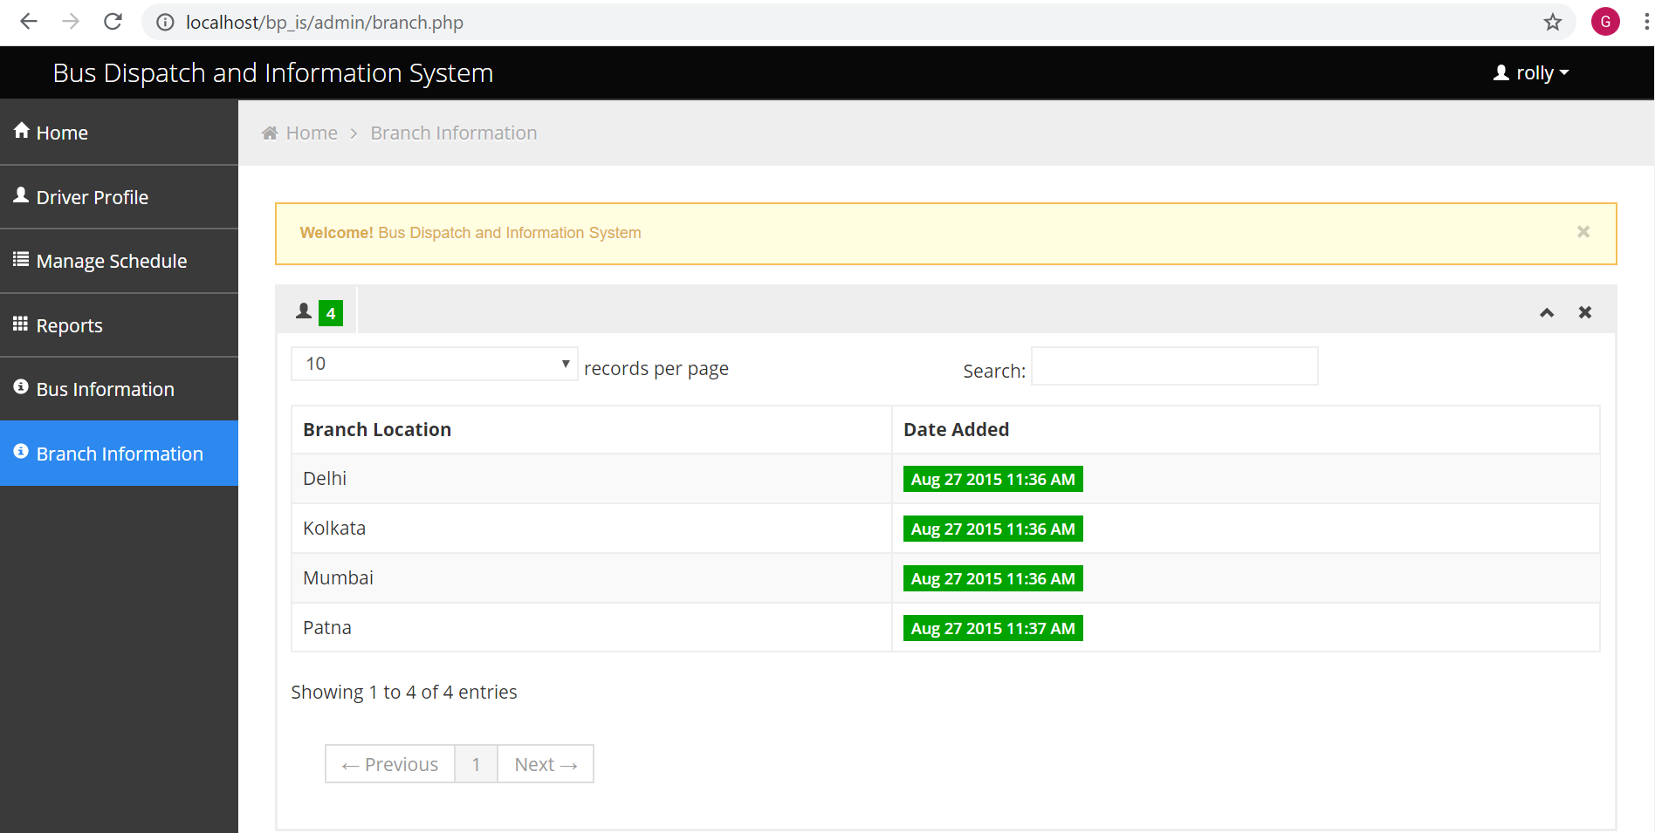
Creating driver account
To book bus
Admin Branch Information

Slide 10
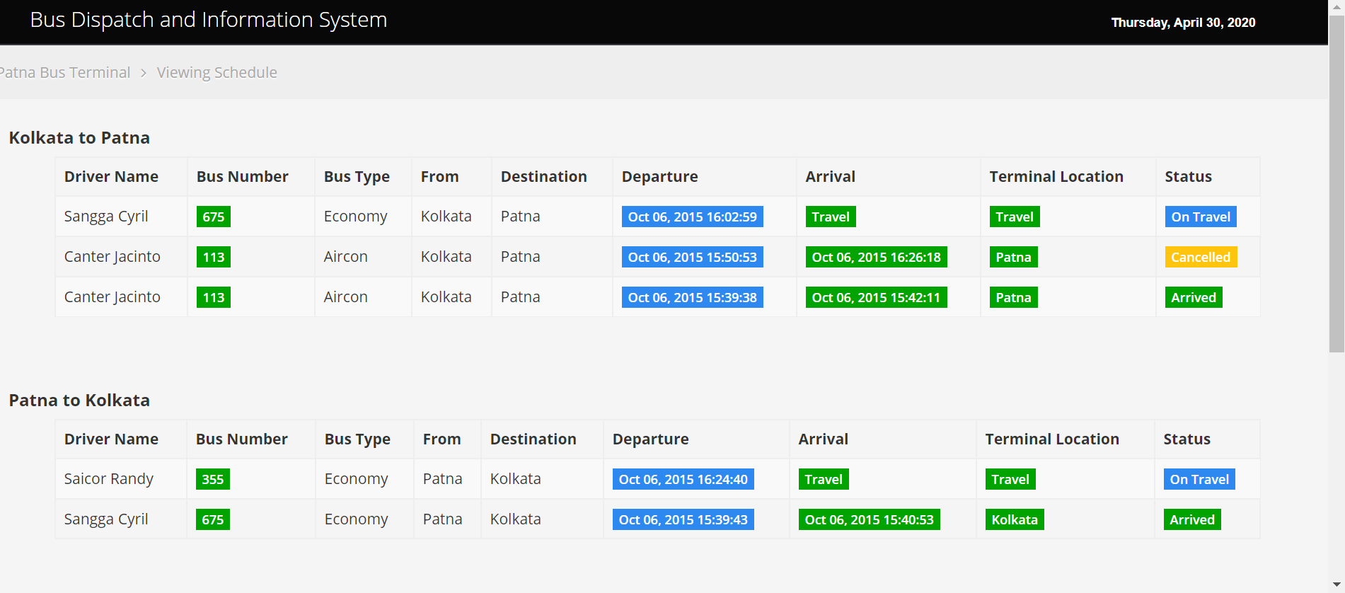
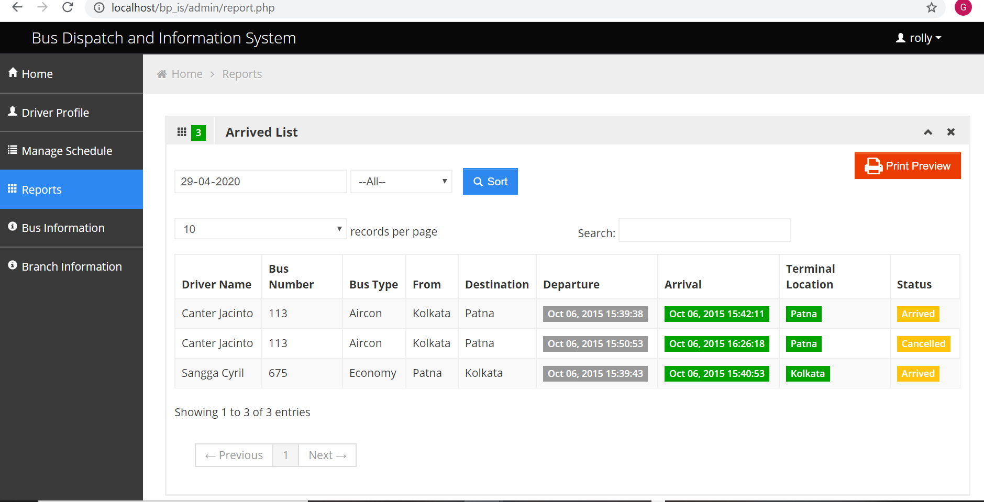
User Information
Confirmation upon arrival

Slide 11
SOLUTION (b)PROMOTE CARPOOLING
Target audience- middle class people who can easily avail the app.
Technology Used- An open source android application which helps people in offering/selecting rides to destination. This app allows users to register using email id and login.
It provides users with mainly three options
Update Profile- allows users to update their personal information
Offer Rides- help users in offering rides to particular destination
Search Rides- allows user to search for any rides to particular destination, book specific rides.
The following snapshots of our app RIDESHARE will make the working more clearer-

Slide 12
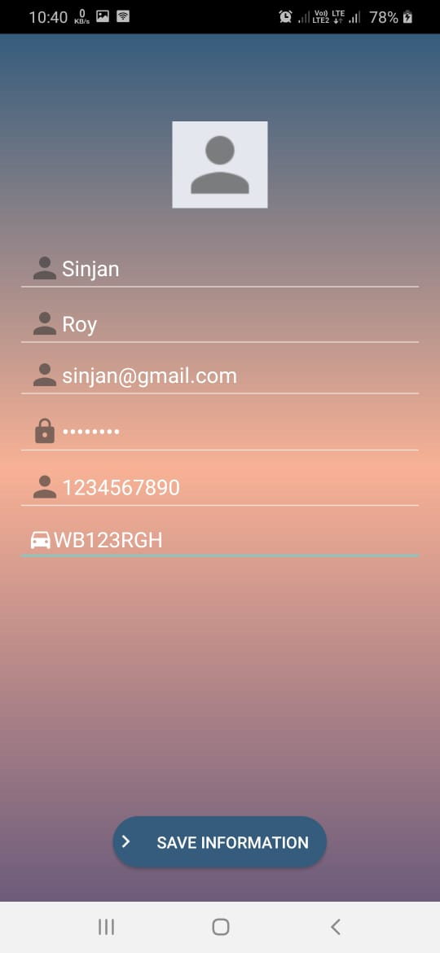
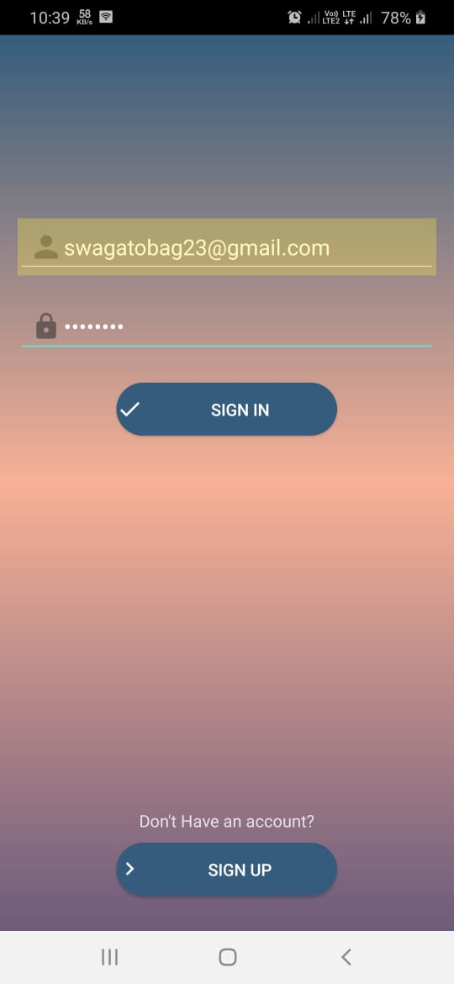
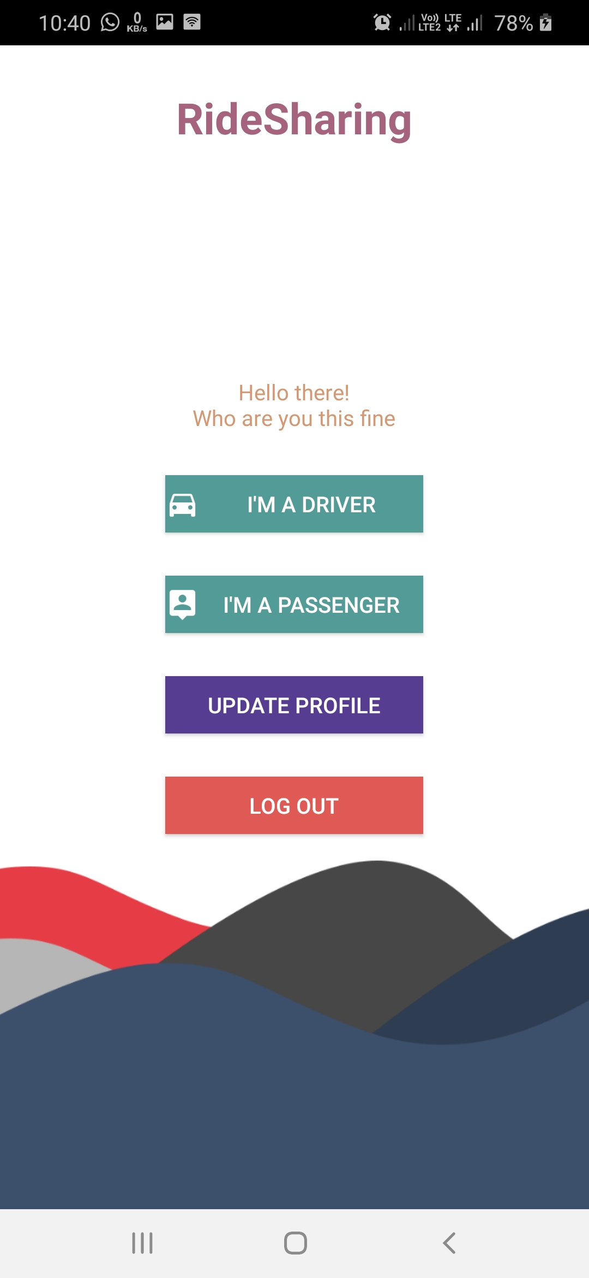
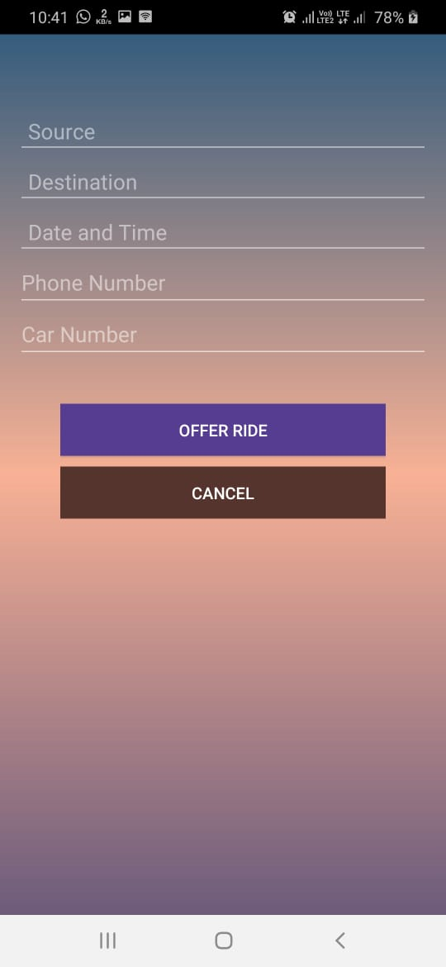
WELCOME TO RIDESHARE
1. Creating an account
2. Signing in
3. Selecting option
(homescreen)
4.Offering ride by giving all required details

Slide 13
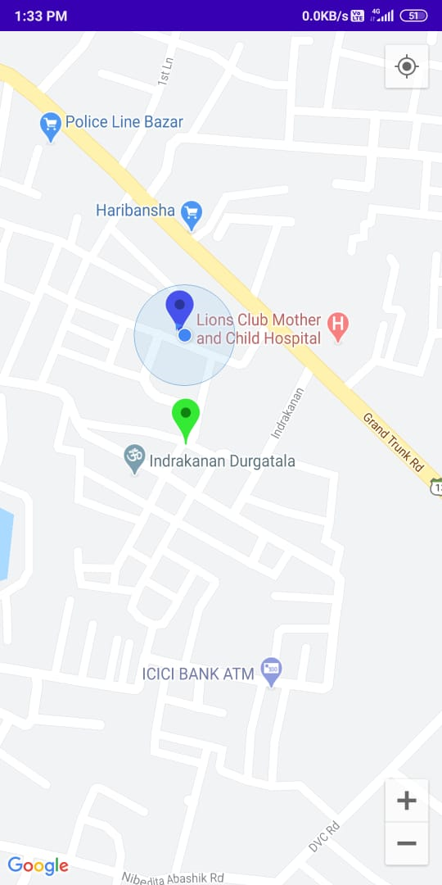
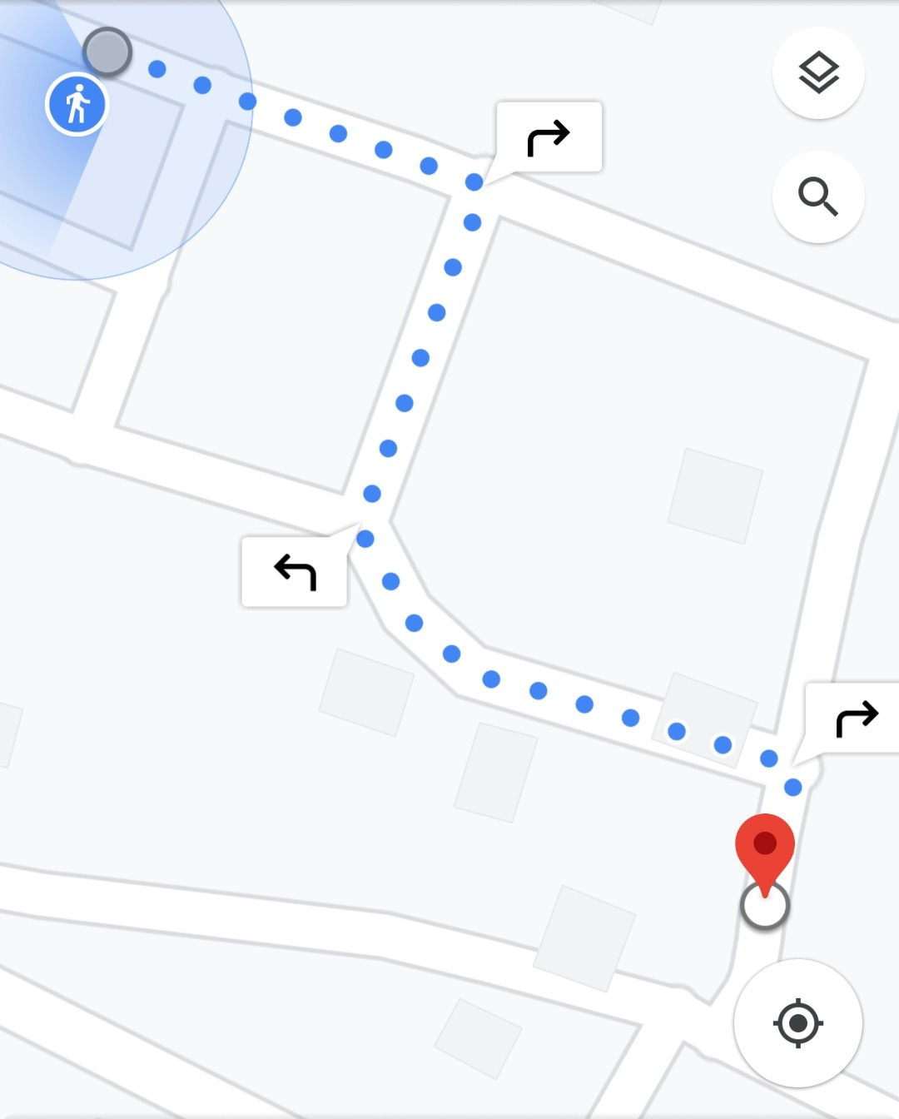
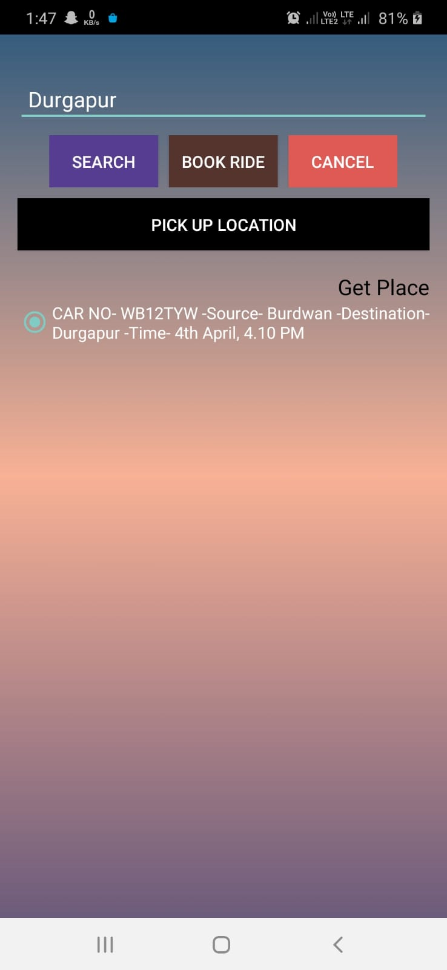
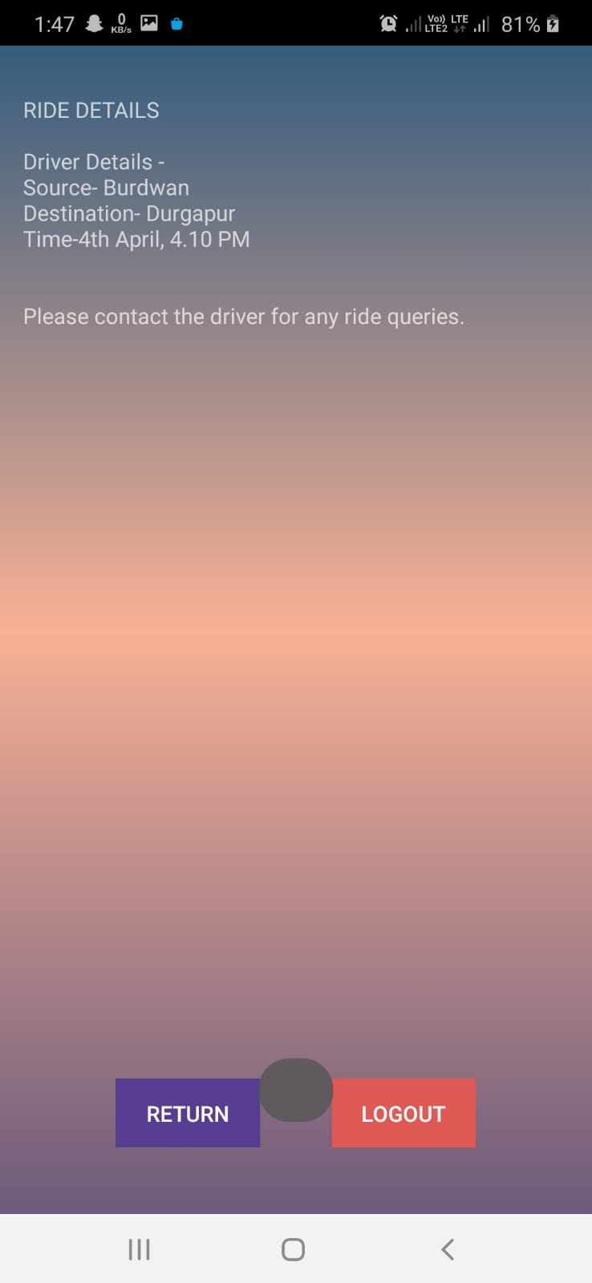
WELCOME TO RIDESHARE
5.Search location
Magnified view of map location
6.Search ride activity and book
7.Booking confirmation

Slide 14
ARCHITECTURE
DIAGRAM
This diagram is a graphical representation of both the models- web and app.
Current location of user is fetched through GPS.
Driver applicant info is send to the Database via GPRS
Distance between co-ordinates is fetched.
Rider applicant receives the nearest available transport facilty from database.

Slide 15
BUSINESS MODEL
FOR THE WEBSITE-
Total addressable market- Students, employees, small scale workers who need to go to a particular location on a daliy basis.
For shophistacated users, we have included the service details of air-conditioned buses and economy buses separately.
To solve the problem of over crowded buses, we can propose the Government to increase the frequency of buses.
Availng public transport is a much cheaper alternative and there's transportation safety to a great extent.
We can also propose the Government to convert few lanes into complete bus lane.
For feasibility of use, people can track the buses using web application at bus stops.
Our model has a drawback that it does not capture the constant update of the traffic.
Our solution can be proved to be better than other proposed ones by the following survey graphs-

Slide 16
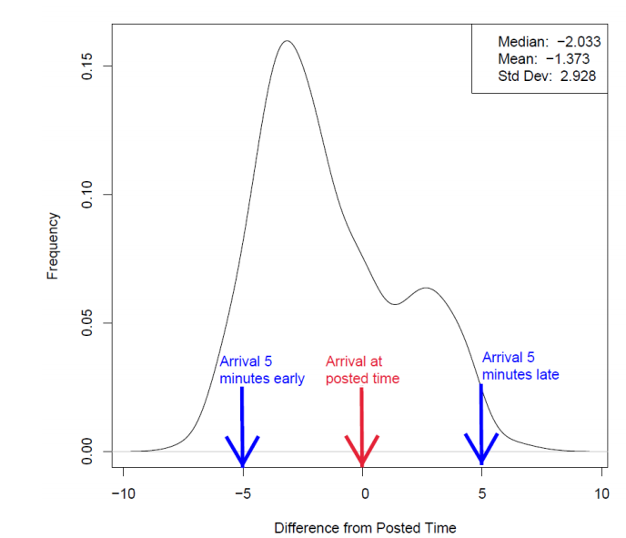
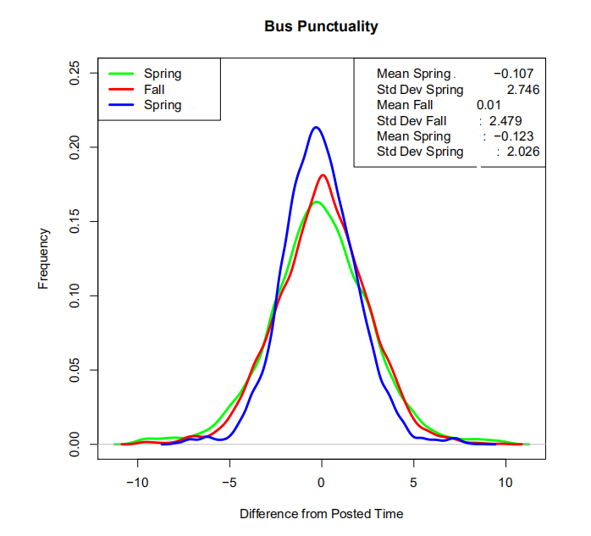
This graph shows the frequency of the buses w.r.t the posted time on a particular day.
This graph shows the punctuality of buses for a particular year.

Slide 17
BUSINESS MODEL
FOR THE ANDROID APP-
On frequently using the app to avail carpooling facility, rewards will be given to user in form of income tax rebate, thus, increasing the market.
This app is easy to use and has a minimalistic UI as compared to other sophisticated apps.
Personal information can be updated easily in the app.
Due to the on going pandemic, our app will only accept at the most 2 requets for a particular car so as to maintain social distancing.
For future enhancements, we have planned to-
Get real time vehicle data for paid/free service
Integrate with a pay service
Planned to confirm booking through an email, which will be implemented upon buying server. Upon booking a ride, a random number will be generated which will be sent to the driver and the user.

Slide 18
THANK YOU

